Slide 1

Linux vs Windows

Slide 2
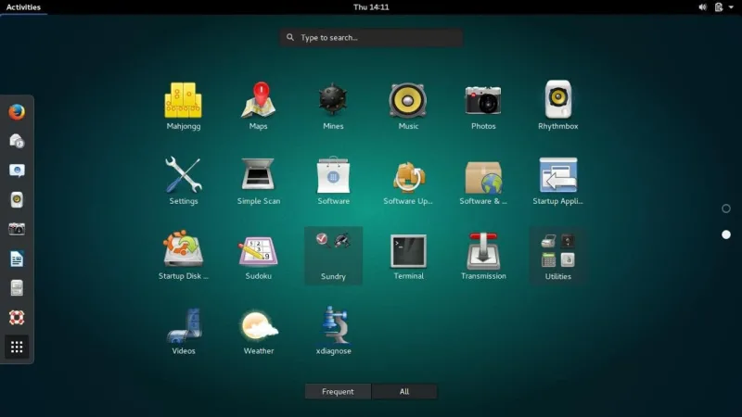
Linux
Linux is the best-known and most-used open source operating system. As an operating system, Linux is software that sits underneath all of the other software on a computer, receiving requests from those programs and relaying these requests to the computer’s hardware.

Slide 3
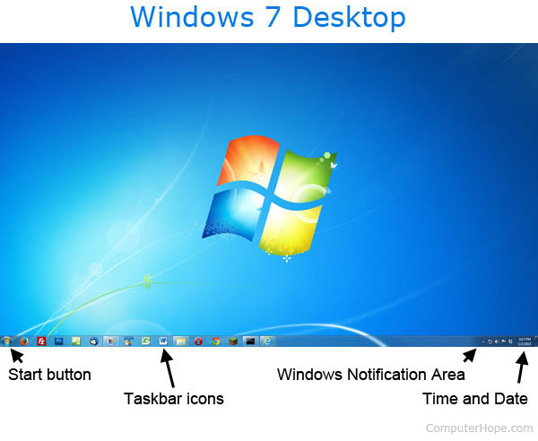
Windows
Microsoft Windows, commonly referred to as Windows, is a group of several proprietary graphical operating system families, all of which are developed and marketed by Microsoft. Each family caters to a certain sector of the computing industry. Active Microsoft Windows families include Windows NT and Windows IoT; these may encompass subfamilies, e.g.

Slide 4
Windows vs Linux
Price
Ease of use
Reliability

Slide 5
Which one is better?
Open Source Nature
Secure

Slide 6
Thank you

